Slide 1
angleBracket

Slide 2


Slide 3


Slide 4

We already do it, why not do it with friends?

Slide 5
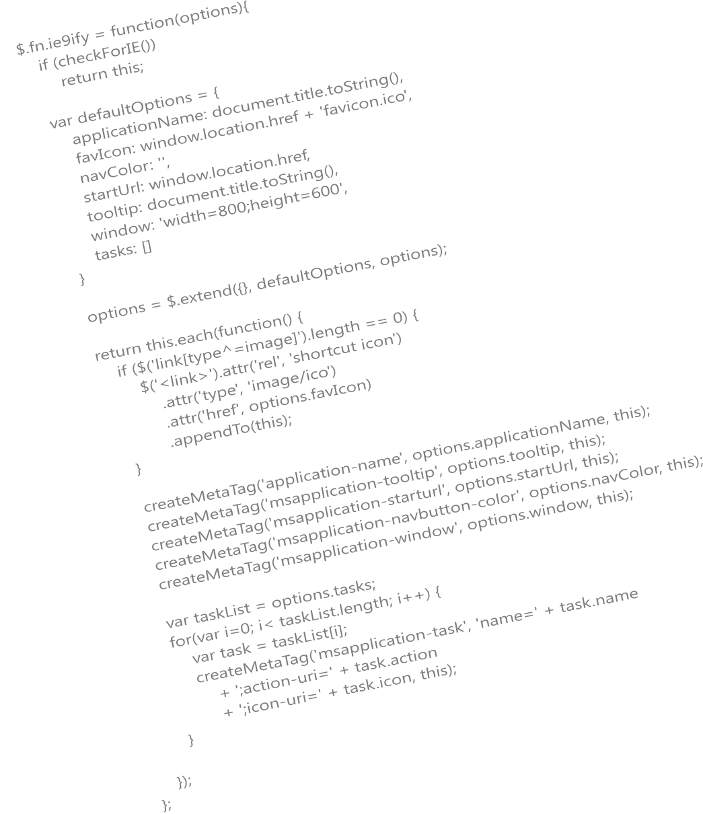

Slide 6
var what = ‘write code’;

Slide 8

> format c:/
Step 1. Introduce a Technology
Step 2. Pair Up and Code
Step 3. Share

Slide 9


Slide 10

Notes:
Photo taken from flickr: http://www.flickr.com/photos/mk30/5801054199/

